Slide 1


Assessment of Low-Carbon Development Technologies in the Iron and Steel Industry
SAUDI ARAMCO & Tsinghua University
Presenter: Yuezhang He, PhD candidate
Nov 27, 2024

Slide 2
Project Timeline
 | Nov | Dec | Jan | Feb | Mar | Apr | May | June | July | Aug | Sep | Oct | Nov | Dec | Jan | Feb | Mar | Apr
Research Proposal & preparations
Overview of China's iron & steel industry
Data requirement & database investigation
Technology assessment
Accounting models & technology report |  |  |  |  |  |  |  |  | 1
Investigation on breakthrough technology industry chain
High spatial resolution data collation
Model development
Data analysis & Scenario design
Final report |  |  |  |  |  |  |  |  |  |  |  |  |  |  |  |  |  | 2
Milestones
  1. Assessment of Low-Carbon Development Technologies in the iron and steel industry: Model & Report
  2. Study on the Evolution of the Industrial Layout of the iron and steel industry: Model & Report

Slide 3
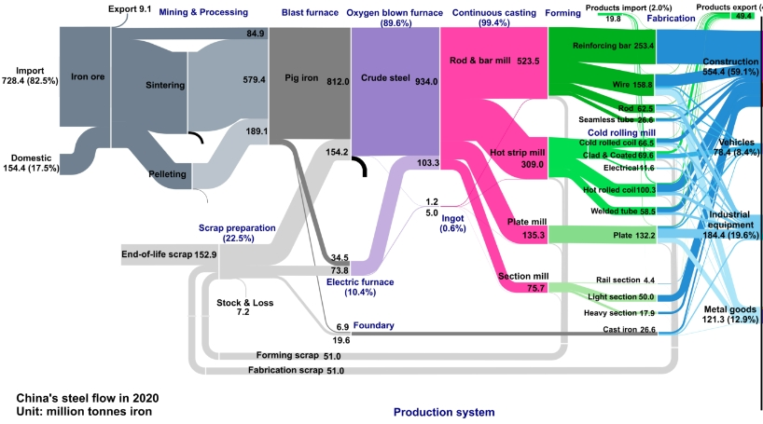
I & S: steel demand & scrap availability
High iron ore external dependence
Scrap types | Description
Home scrap | Produced in the production process of steel, recycled within the factory, and utilized within the facility where it was created
Prompt scrap | Produced during manufacturing of metal products and no facilities to process internally
Obsolete scrap | Scrapped from all kinds of metal products, equipment, constructions, etc., after a certain number of years of use
Source: Yang, H., Ma, L., & Li, Z. (2023). Tracing China's steel use from steel flows in the production system to steel footprints in the consumption system. Renewable and Sustainable Energy Reviews, 172, 113040.

Slide 4
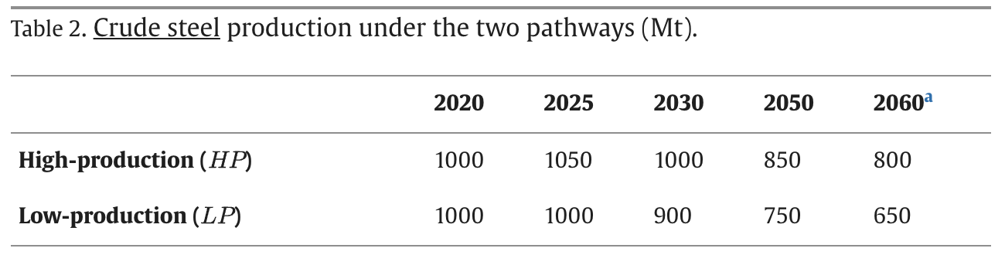
Forecast of steel demand & scrap availability
The high-production pathway uses the production levels from the IEA stated policy scenario and the low-production pathway uses the production levels from the IEA sustainable development scenario
Scrap-based is assumed 50% by 2060.
IEA (2020) Iron and Steel Technology Roadmap.
Xiang Yu, Chang Tan, China’s pathway to carbon neutrality for the iron and steel industry, Global Environmental Change

Slide 5
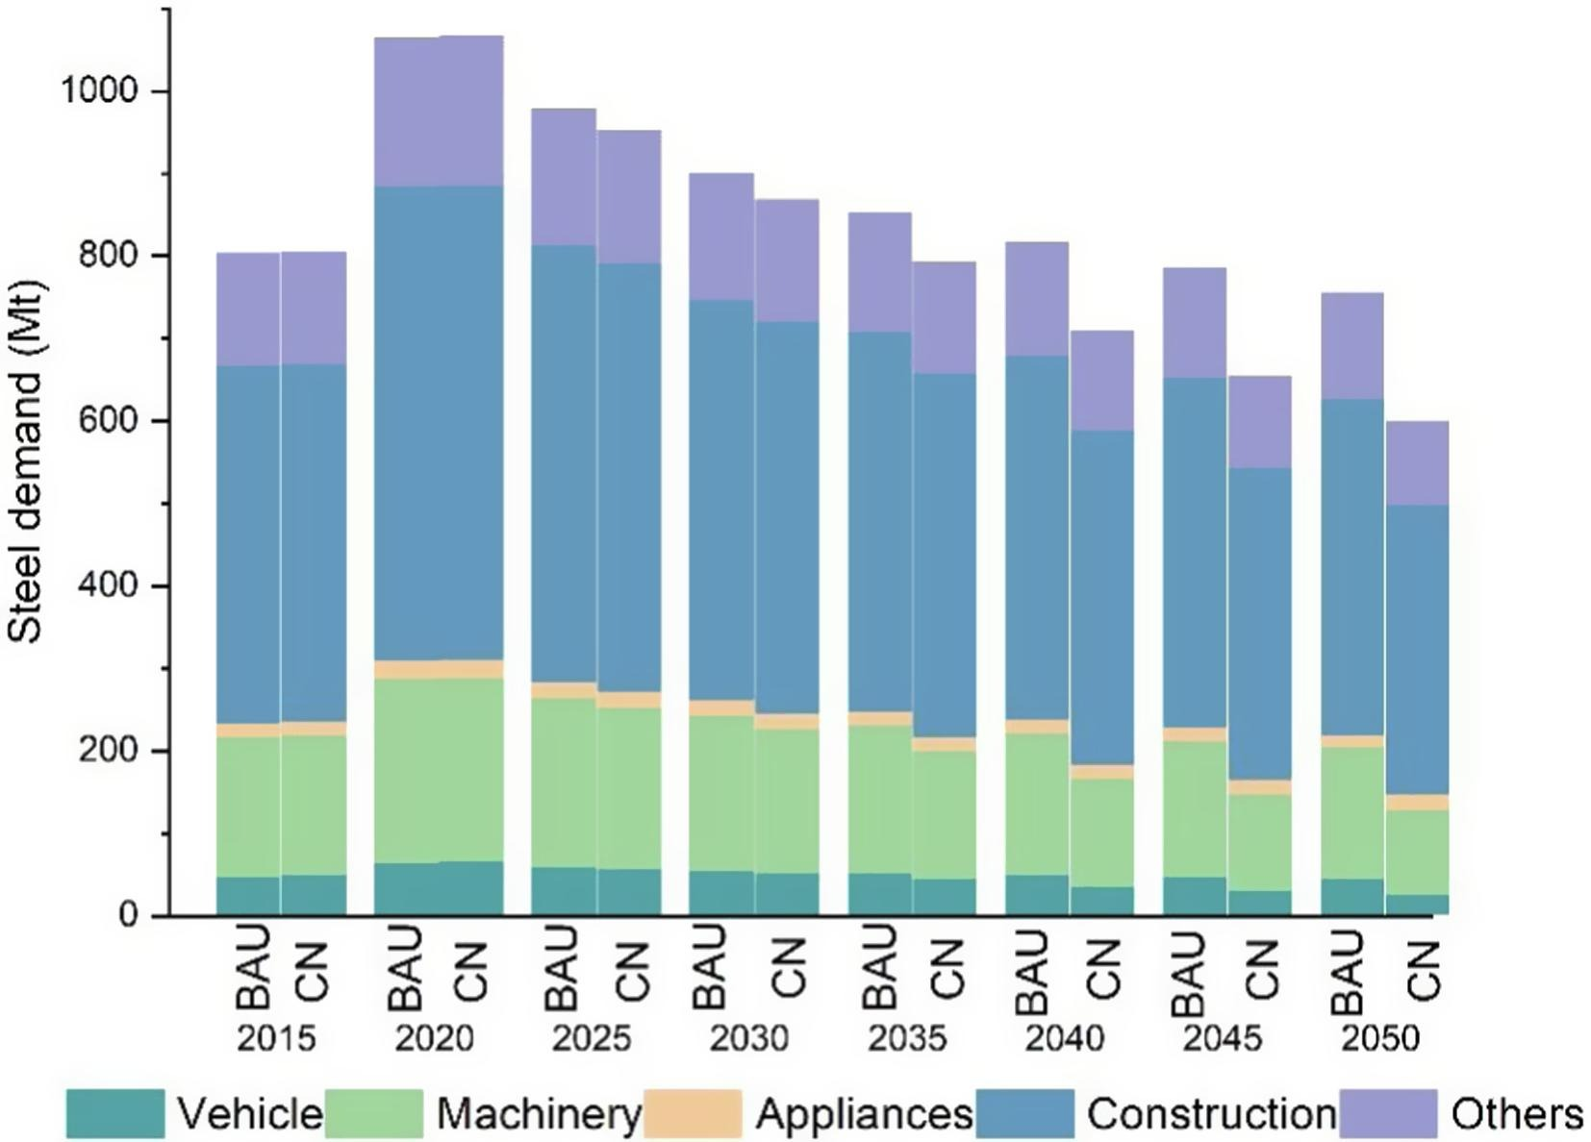
Forecast of steel demand & scrap availability
Under the BAU scenario, steel demand peaks at 1064.77 Mt in 2020 before declining to 756.09 Mt in 2050; Under the carbon-neutrality scenario, steel demand decreases to 866.35 Mt in 2030 and 597.70 Mt in 2050, 4% and 21% lower than the BAU scenario
The maximum scrap-based EAF share will gradually increase from 6% in 2015 to 25% and 40% in 2050 in the low and high scrap cases, respectively
Ming Ren et al., Decarbonizing China’s iron and steel industry from the supply and demand sides for carbon neutrality, Applied Energy

Slide 6
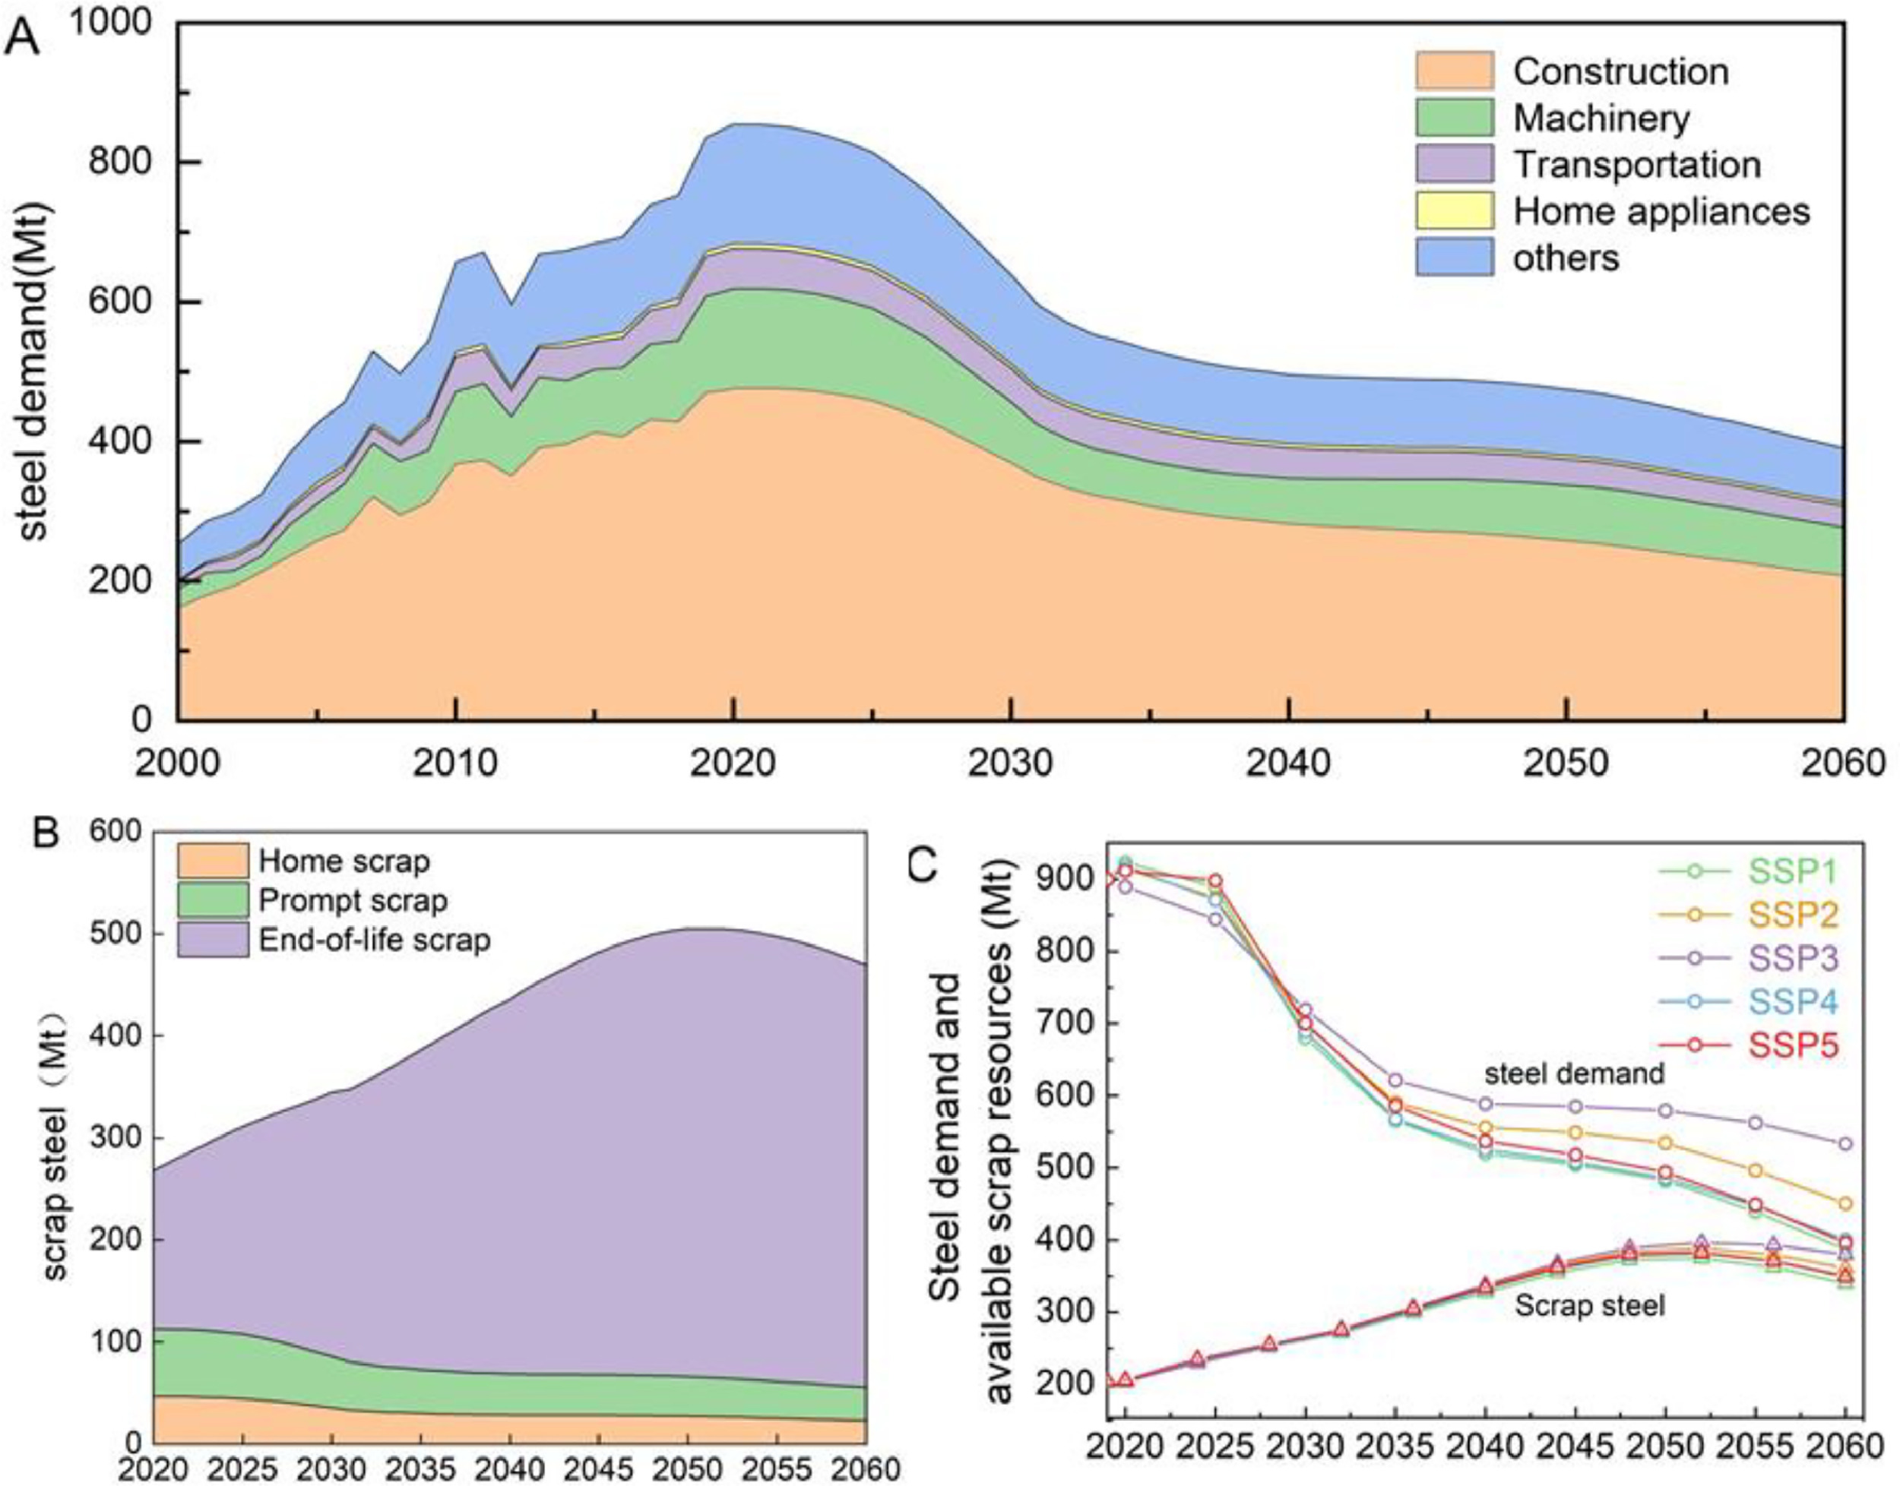
Forecast of steel demand & scrap availability
Steel consumption in construction will show a clear downward trend.
Could have growth potential in transportation?
Scrap may also peak and decrease then (~30 years later than steel peak).
Other studies: 350~550 Mt of scrap by 2050
Yaxin Wang, Jun Liu, Xiaolong Tang, Yu Wang, Haowen An, Honghong Yi, Decarbonization pathways of China‘s iron and steel industry toward carbon neutrality, Resources, Conservation and Recycling,

Slide 7
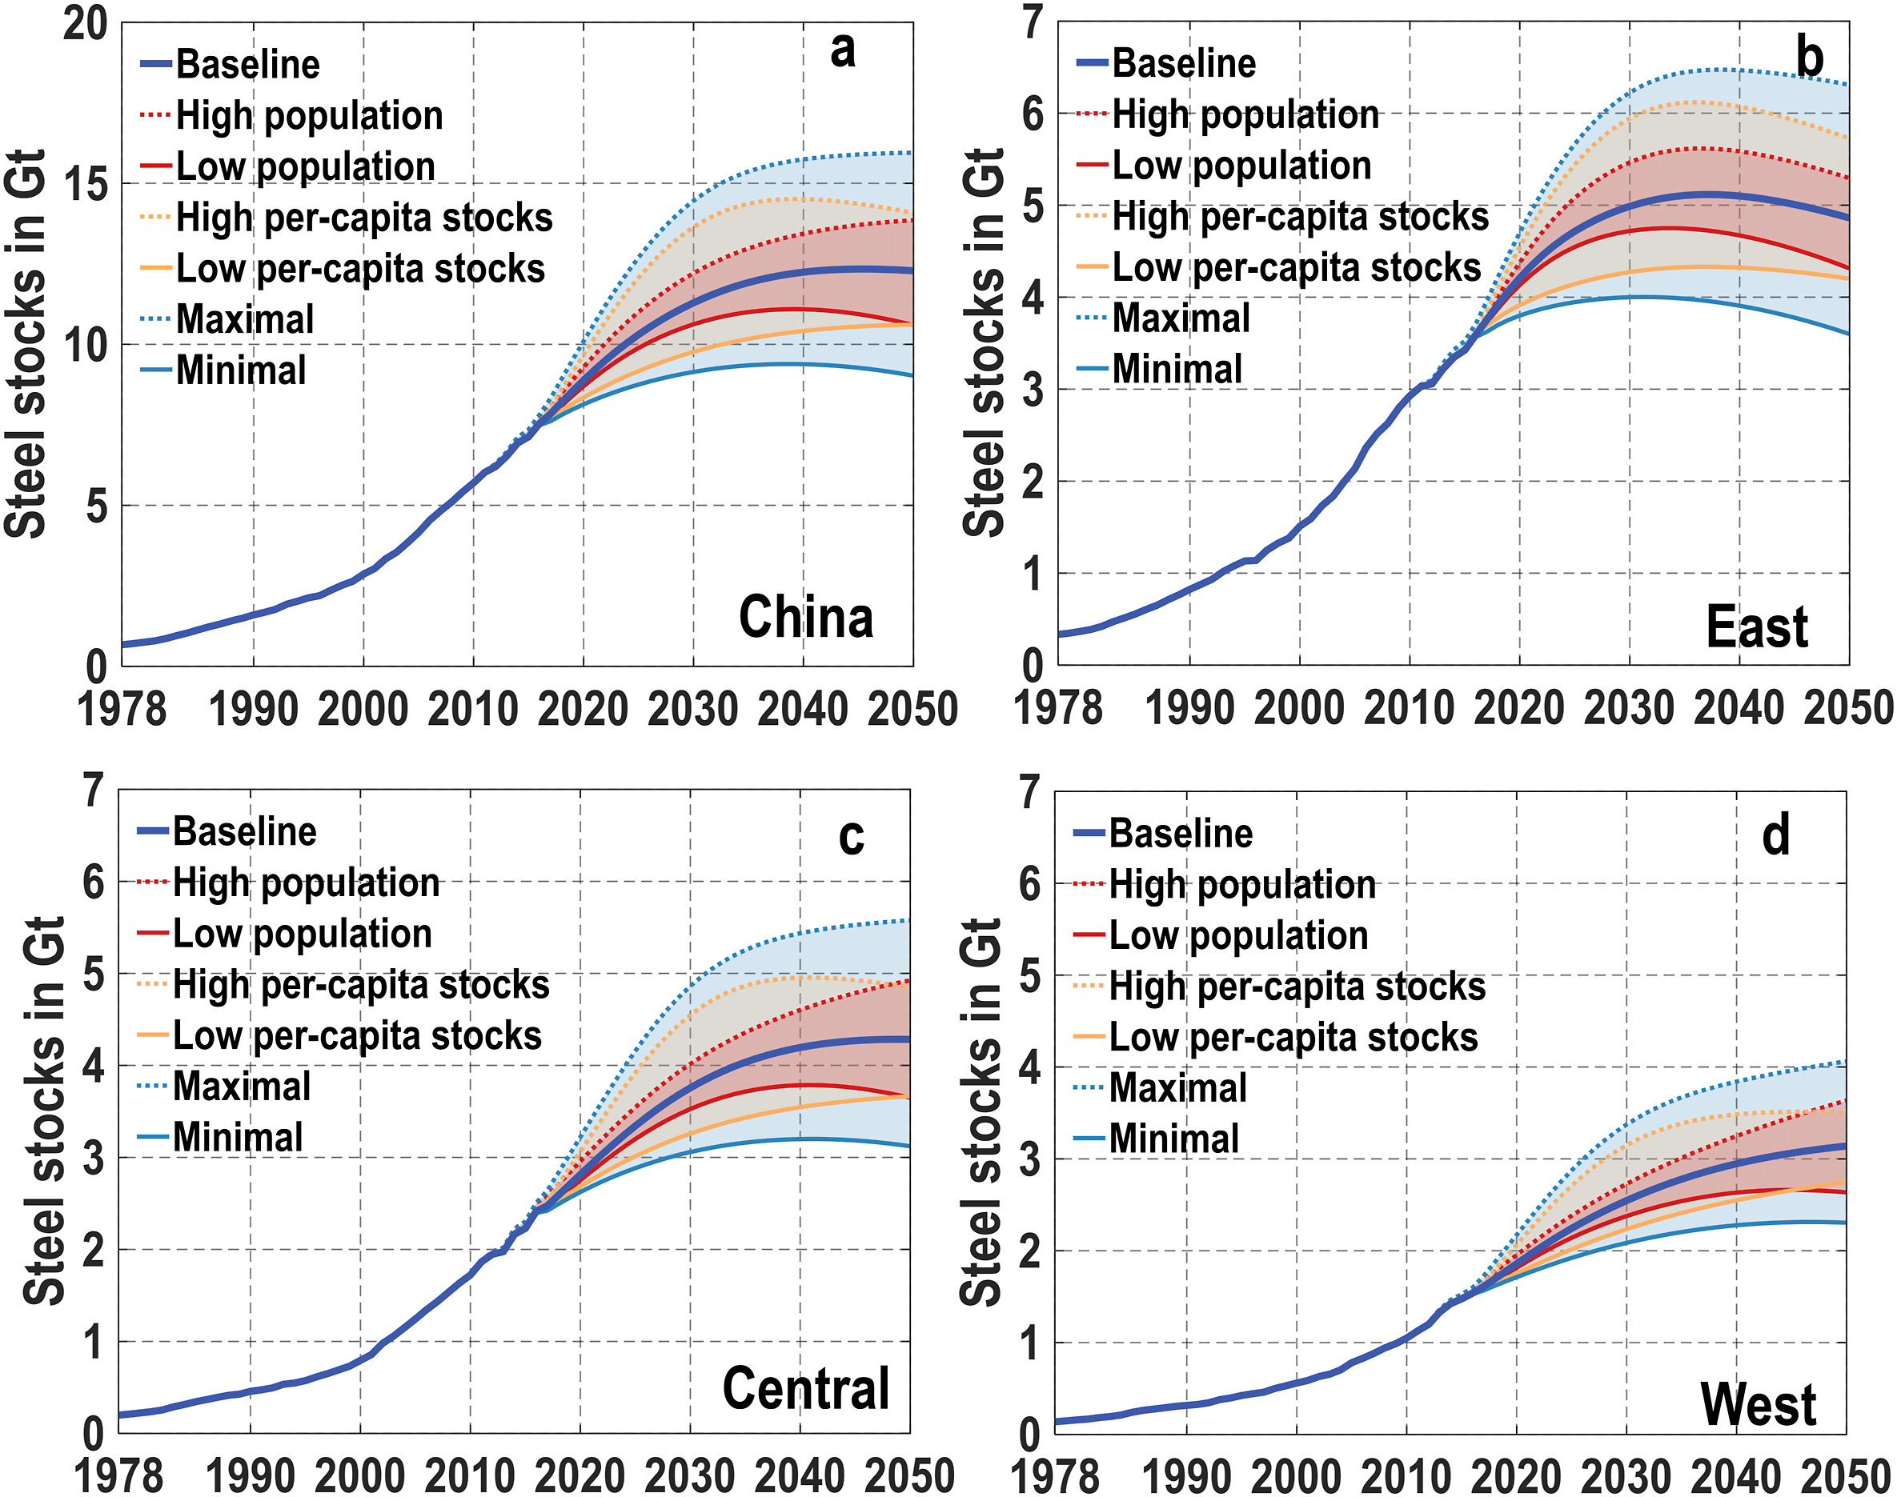
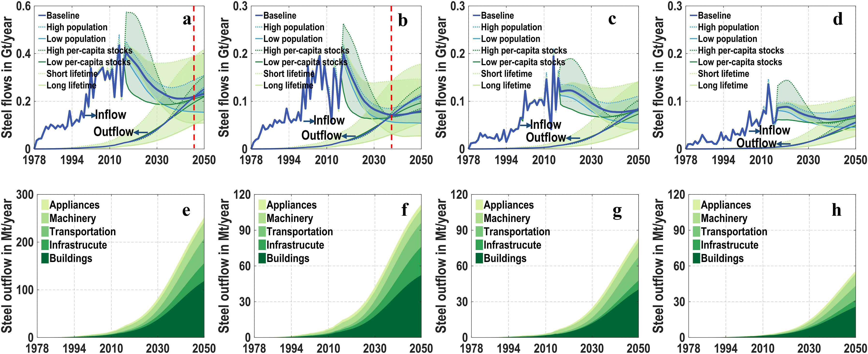
Forecast of steel demand & scrap availability
A bottom up approach (100+ commodities, steel contents), provincial level
Dynamic material flow analysis: stock, inflow, outflow; by region & by consumption sector
Far less than the actual production (incomplete scope/indirect export?)
Fig. 5. Steel flows by scenario and scrapped steel supply by sectors in China (a and e), eastern region (b and f), central region (c and g), and western region (d and h).
Fig. 4. Forecasted change in steel stocks in China (a), eastern region (b), central region (c), and western region (d).
Lulu Song, Peng Wang, Min Hao, Min Dai, Keying Xiang, Nan Li, Wei-Qiang Chen, Mapping provincial steel stocks and flows in China: 1978–2050, Journal of Cleaner Production.

Slide 8

Forecast of steel demand & scrap availability
Regional steel demand (literature) breakdown into provincial level based on GDP
Before & after saturation, using different estimation functions for steel demand per capita
Scrap availability classification: partially endogenous

Slide 9
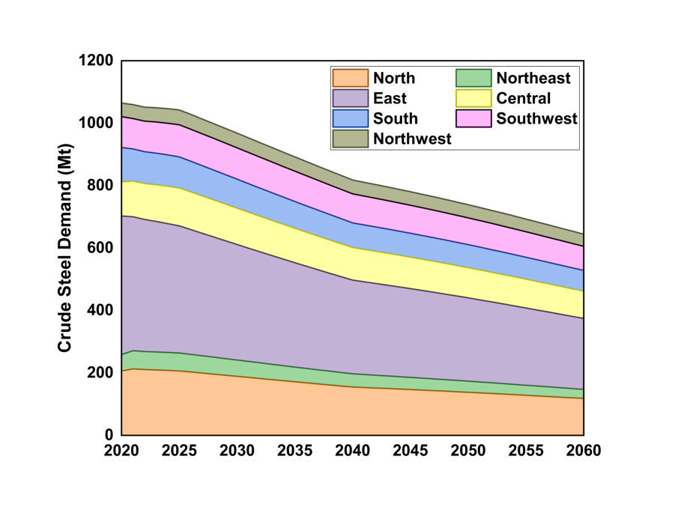
Forecast of steel demand & scrap availability
National steel demand is forecast to decrease to 645 Mt in 2060 (60% of 2020 level)
The decreasing trend is mainly driven by North China and East China

Slide 10
Thank You For Your Attention!
Yuezhang HE
PhD candidate
Department of Energy and Power Engineering
Tsinghua University
Email: heyz21@mails.tsinghua.edu.cn
Notes:
https://www.semanticscholar.org/paper/1-CHAPTER-11-CCS-in-the-Iron-and-Steel-Industry-McQueen-Woodall/338e0ba3c2d644ba80a80a4f1b8bb7894f4683e1

